Slide 1
A-08 Software and Data Integrity Failures
Open Web Application Security Project OWASP TOP 10
ThriveDX

Slide 2
Overview
New category for 2021
One of the highest weighted impacts from Common Vulnerability and Exposures/Common Vulnerability Scoring System (CVE/CVSS) data
Its focus is on making assumptions related to software updates, critical data, and CI/CD pipelines* without verifying integrity.
It relates to code and infrastructure that does not protect against integrity violations.
* A CI/CD pipeline is a set of automated processes that are used to continuously build/test/deploy software applications. CI/CD stands for Continuous Integration and Continuous Deployment or Delivery.

Slide 3
Software & Data Integrity Failures - Common Weaknesses and Vulnerabilities
CWE-345 Insufficient verification of Data Authenticity
CWE-494 Download of Code without Integrity Check
CWE-829 Inclusion of Functionality from Untrusted Control Sphere
CWE-830 Inclusion of Web Functionality from an Untrusted source
CWE-565 Reliance on cookies without Validation and Integrity Checking

Slide 4
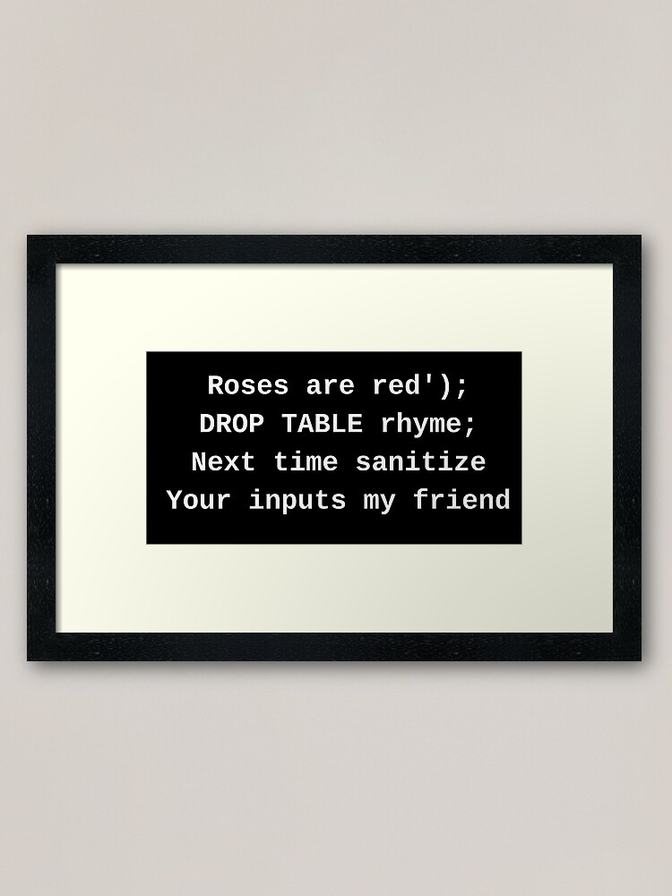
How to prevent Software & Data Integrity Failure
Use digital signatures for software component verification
Use secure repositories for libraries and dependencies
Enforce secure code reviews
Implement a software supply chain security program
Notes:
https://crashtest-security.com/owasp-software-data-integrity-failures/

Slide 5
Why this case?
On the official website, I found an interesting scenario
https://owasp.org/Top10/A08_2021-Software_and_Data_Integrity_Failures/.
Scenario #3 Insecure Deserialization: A React application calls a set of Spring Boot microservices. Being functional programmers, they tried to ensure that their code is immutable. The solution they came up with is serializing the user state and passing it back and forth with each request. An attacker notices the "rO0" Java object signature (in base64) and uses the Java Serial Killer tool to gain remote code execution on the application server.

Slide 6
Insecure Deserialization Attack
How it works

Slide 7
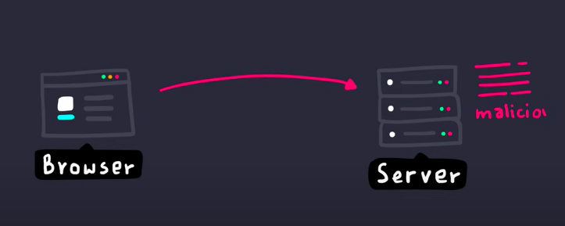

Slide 8

Simpler

Slide 9
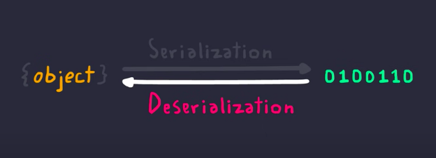
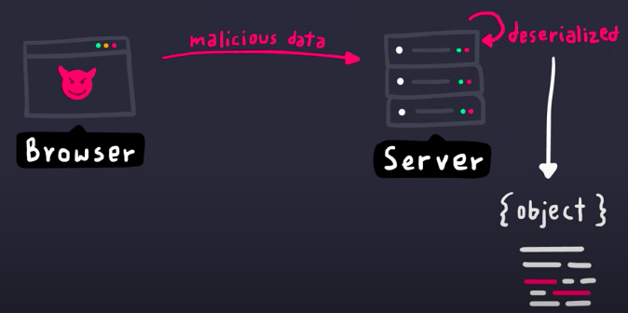

Slide 10
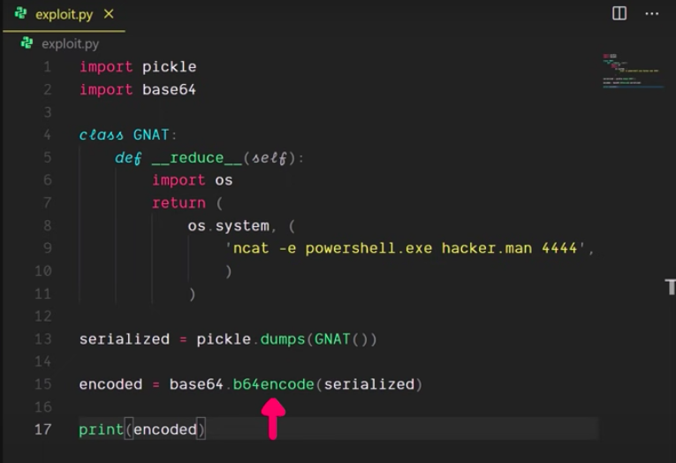

Slide 11
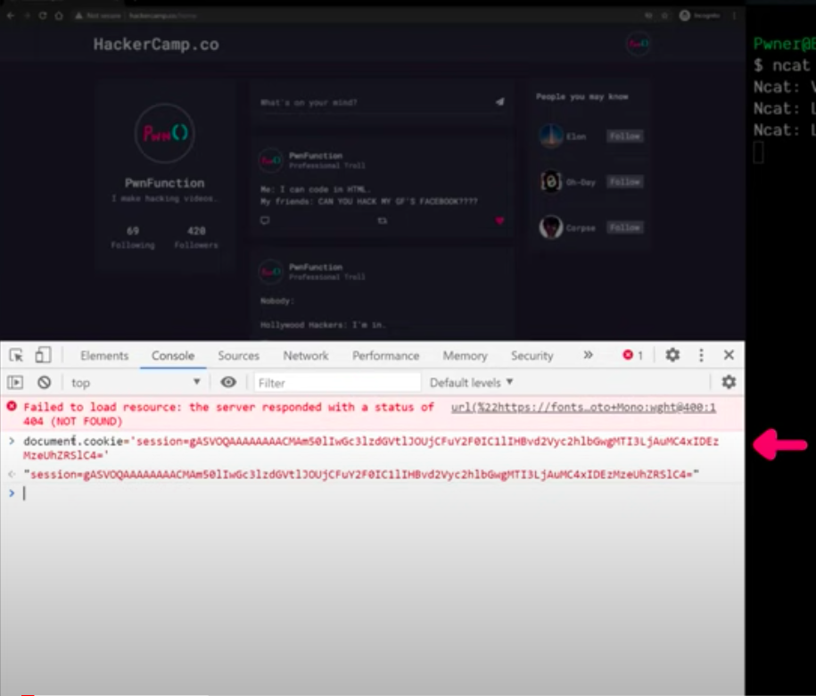
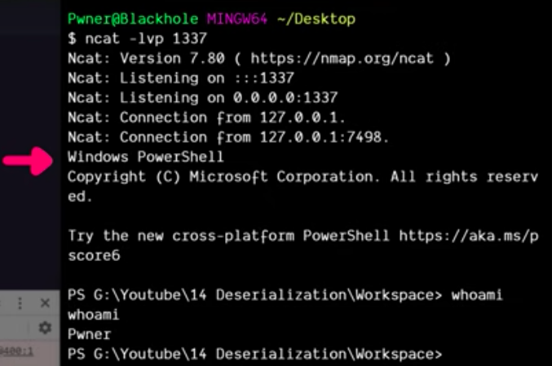

Slide 12
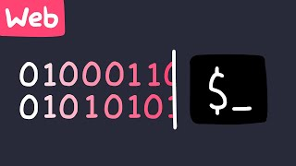
Case

